Slide 1
Alcon Week of 1/27 Updates

Slide 2
Status of Items
Stage Controller – Ordered
Pugh Matrix, Hardware – in Progress, Everyone
Pugh Matrix, Software – In Progress, Everyone
Z-axis design – In Development, Yolanda, Brian, Matthew
Stage Controller Design – Awaiting Pugh Matrix for Comparison, Yolanda, Brian
Portfolio of Project Progress – Ongoing, Everyone

Slide 3
Future Goals:
Python and OpenCV – Want to continue researching to complete code after stage controller design, Landon, Isaac, Tandol
Particulate Optics – Research Polarization (plane, circular) to increase visibility of particles, Brian, Landon
FMEA – Continue Developing, adding to list of modes, Everyone
Update Pugh matrix, hardware, Hardware team
Finalize stage controller design, Hardware team

Slide 4
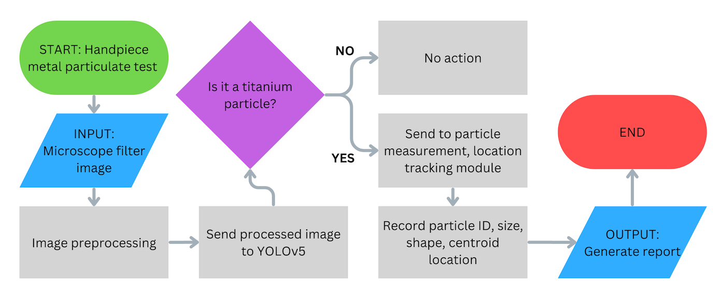
Software flowchart

